Slide 1
MBAA Meeting
April 13th, 2011 at

Slide 2
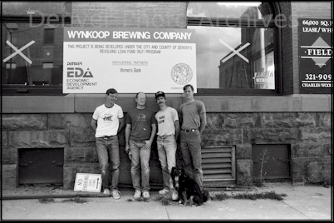
Wynkoop History
Company Founded in 1988
Colorado’s First Brewpub
Helped Establish LODO neighborhood
WIN-koop or WHINE-koop?
One of Largest American Brewpubs

Slide 3
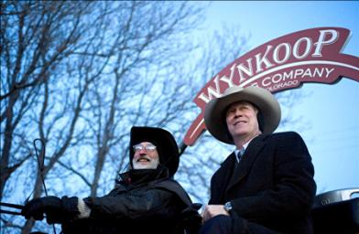
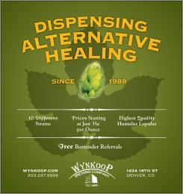
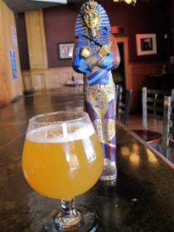
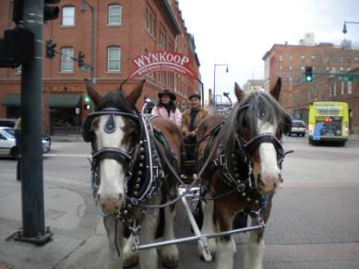
Wynkoop Present
-Began Canning in 2010
-Self-Distribution Efforts
-Increased Production 25% in 2010
-Collaboration Beers
-Beer Dinners, Beer Festivals
-Joint Venture with Breckenridge Holdings
-Increased Seasonal Offerings
-Having Fun, improving image
-Bringing Back Customers

Slide 4
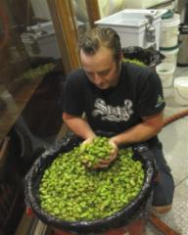
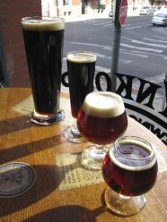
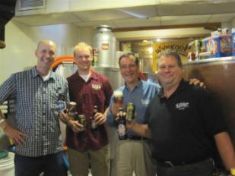
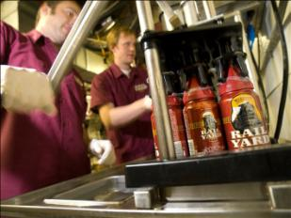
Wynkoop Future
Focus on beer quality and consistency
Shift can and keg production to Breckenridge
Update and improve equipment
Attract new customers while keeping the old
Expand our Colorado market for kegs/cans
Adapt to changing consumers tastes/trends
Enjoy the Craft Beer culture in Colorado

Slide 5
Tonight’s Topic:
The Changing Nature of Innovation in craft brewing
Inspired by The Brewers Association Russell Schehrer Award for Innovation in Craft Brewing
  Who was Russell Schehrer?
  What made them want to name an award after him?
  What made Russell influential to early craft brewers?
    Produced mead, cream stout, barley wine, chili beer
    Cask conditioned beer (Warm and Flat is where it’s at!)
    Big personality, talked to many people
    Made some good beer!

Slide 6
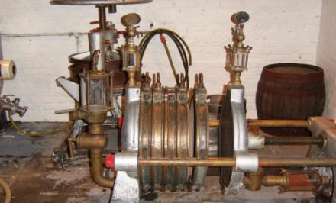
    Definition of INNOVATION:
    1: the introduction of something new
    2: a new idea, method, process, or device*
Example of innovative brewing device
(circa 1930?)
What makes craft brewers and their beers innovative?
  Or are we repackaging old ideas under a new name

Slide 7
Exciting Times for Craft Beer!
Ever increasing selection on the market
Increased volume and price points for craft
Not your dads craft beer (2nd generation)
Industry Rock Stars with TV shows
Nanobreweries, start ups abound
Macro breweries successful craft forays
Market saturation (late 90’s shakeout?)
Is Innovation what is driving craft sales?

Slide 8
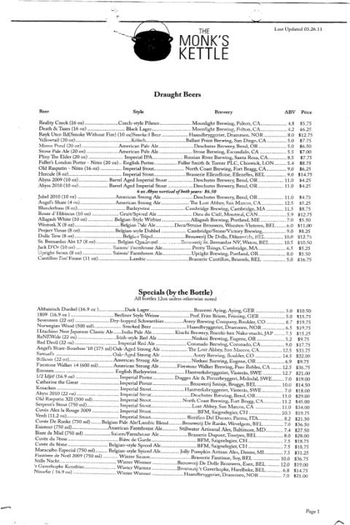
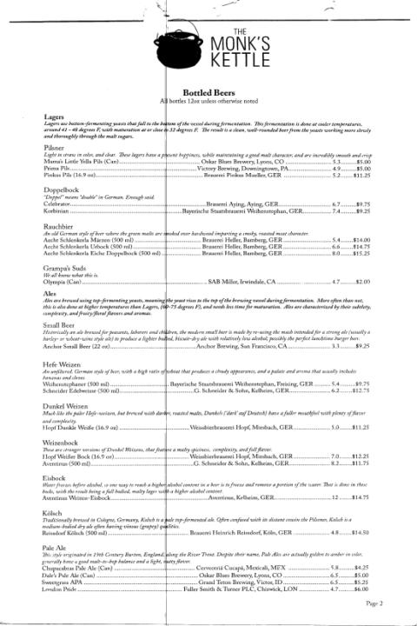
Exciting times for Craft Brewers

Slide 9
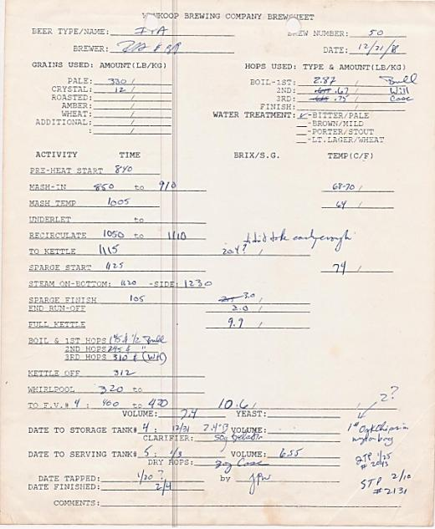
Let’s look at some of Russell’s recipes:
Wynkoop had four hop varieties for all beers in 1988:
Bullion, Willamette
Cascade, Hallertau
Hop Dosage rate for IPA:
.75lb/barrel or 290g/hl
Compare to 3lb/barrel average reported by Matthew Brynildson of Firestone Walker, New Brewer Magazine, 2009
Use of oak chips in conditioning
Traditional English I.P.A’s may
Have approached 8% A.B.V. and
5 pounds per barrel of hops
-Dr. Terry Foster (beer historian)

Slide 10
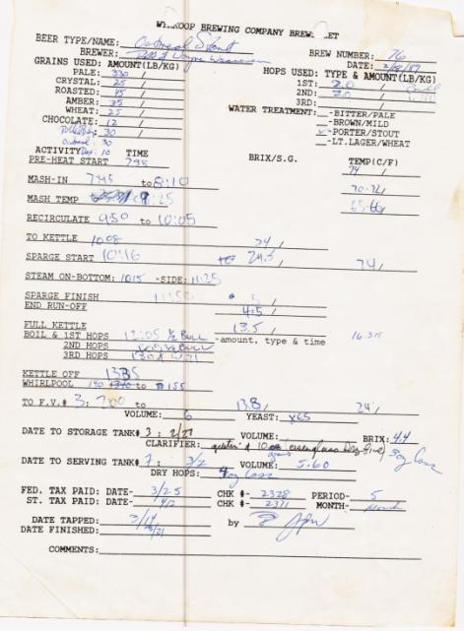
Oatmeal Stout Recipe
Base Malt for all beers was Hugh Baird Maris Otter Pale Malt
Would substitute a portion of “American 2-row” in lighter beers
Why do modern craft brewers fill their silos with heavily modified pilsner malt and add specialty malts for body instead of requesting darker base malt?
8.4% Roasted Barley
13.8 Plato O.G.
3 Oz. Dry Hop Addition
Finings, no filtration
Extensive Water Mineral Treatment
Good, Solid Stout Recipe!

Slide 11
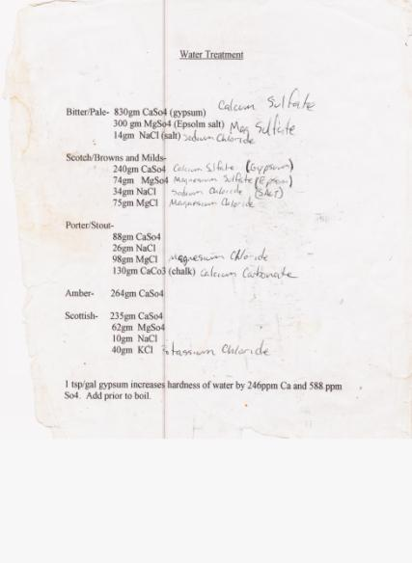
Russell’s Brewing Water Treatment
Typical Burton-on-Trent Analysis:
Calcium (ppm):294
Sulfates (ppm):800
Magnesium (ppm):24
Sodium (ppm):24
Chloride (ppm):36
Carbonates (ppm):200
Bitter/Pale water treatment plugged into in house calculator at right, compared to typical Burton-on Trent water analysis

Slide 12
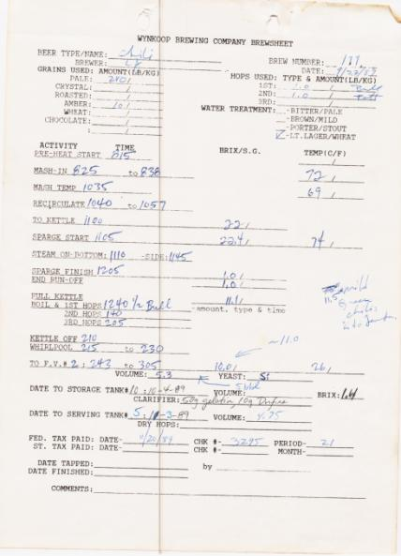
Chile Beer and Spiced Beers
Craft Brewers are increasingly using all kinds of non-traditional ingredients in beer
  Fruits, herbs, spices, woods. What else?
Would this be innovative to traditional Belgian Brewers?
What is a beer style anyway?
-Usually defined by classic example of style, which were all new at one point
-Can be regionally defined
-Whatever brewers are making and selling a lot of becomes a style
-Who cares? Beer Judges
Ultimately, consumers decide if they like
a beer by purchasing it

Slide 13
Imperial and High Alcohol Beers
Brewers keep making ever higher alcohol beer
Recent Craft Brewers Conference presentation by Tyler King of the Bruery detailed how they achieved 20+% A.B.V. beers
Sake Brewers achieve naturally fermented beverages of over 20% A.B.V. for hundreds of years through a similar process
The Chancellor beer recreation from early 1900’s recipe from Terry Foster
Are freezing distilled beers like Tactical Nuclear Penguin from Brewdog still beer?
How do these beers taste?

Slide 14
Conclusions and Thoughts
American Craft Brewers are exerting some degree of influence on beer culture around the world.
Our innovation as craft brewers is that American ability to take the ideas of the past and as we are not bound by tradition, create something new and interesting from them. The melting pot of innovation.
The consumers who buy our beer are the fuel that fans the flame of innovation, for without them, we are just making beers to impress ourselves and each other.
What is old is sometimes new in brewing.

Slide 15
Thank You for your attention.
Questions or Discussion?

